Slide 1
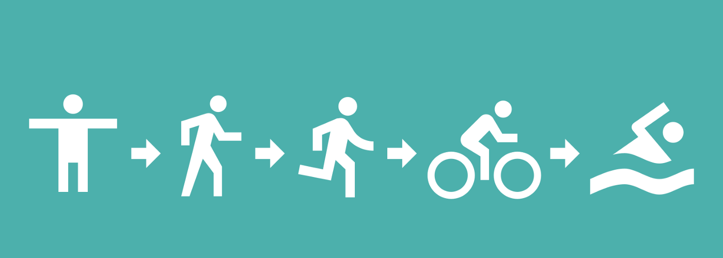
Human activity recognition using smartphone samples

Slide 2

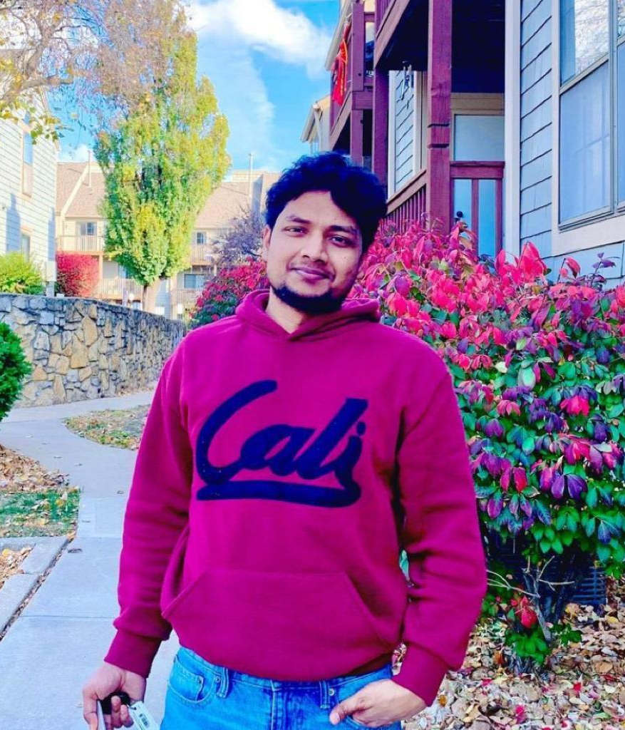
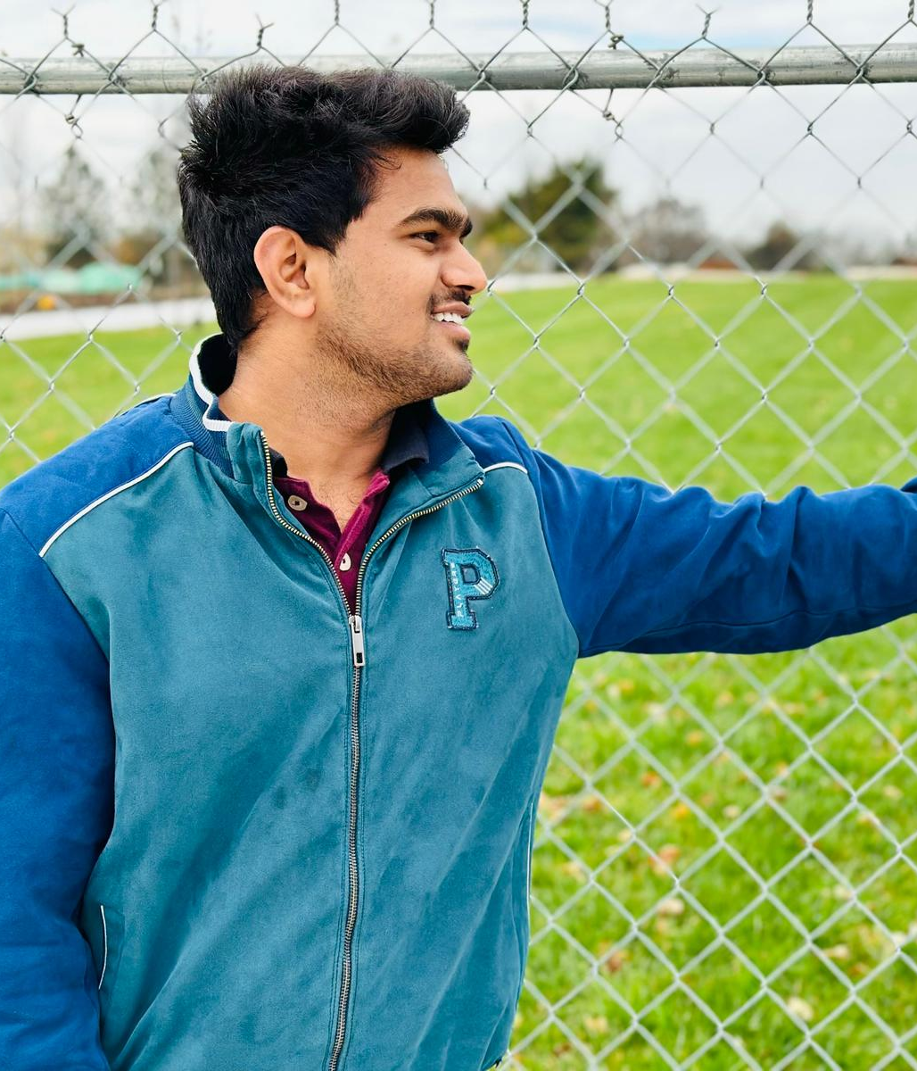

Team Members Info
Tanuja Pasupuleti
700727418
Sandeep Kumar Rai
700727688
Sai Kumar Ganjai
700729622
Jagadeeshwar Reddy Mallepalli
700734515

Slide 3
Roles and responsibilities
Tanuja Pasupuleti
700727418
Sai Kumar Ganjai
700729622
Sandeep Kumar Rai
700727688
Jagadeeshwar Reddy Mallepalli 700734515
Creating project flow chart and work allocation and defining the goals
Data preprocessing
Exploratory data analysis
Implementing PCA and visualizing the results
Training the machine learning models
Conducting performance evaluation
Creating Web interface
Project Proposal Documentation
Final Increment Documentation
Creating project flow chart and work allocation and defining the goals
Collecting the literature related to the methods
Exploratory data analysis
Implementing PCA and visualizing the results
Conducting performance evaluation
Creating Web interface
Incremental Documentation
PPT Documentation
Final Increment Documentation
Creating project flow chart and work allocation and defining the goals
Collecting the literature related to the methods
Data preprocessing
Exploratory data analysis
Implementing PCA and visualizing the results
Conducting performance evaluation
Creating Web interface
Project Proposal Documentation
Final Increment Documentation
Creating project flow chart and work allocation and defining the goals
Exploratory data analysis
Implementing PCA and visualizing the results
Training the machine learning models
Conducting performance evaluation
Creating Web interface
Incremental Documentation
Final Increment Documentation
PPT Documentation

Slide 4
Motivation
Mobile phones are the devices which can be found in the hands of every person and one of the best feature in mobile is to generate human activity samples from the in built motion sensors. With this information it can recognise the few activities like walking i.e. number of steps and tilts when we are playing. With the limited number of activities recognition researchers are looking for categorizing the more activities with its applications in medical industry. For this task we need more data and efficient algorithms which can separate the activities. Machine learning classification algorithms finds the patterns with more insights than traditional algorithms.

Slide 5
Objectives
Predicting one of the classes(sitting, standing, lying, walking, walking upstairs and walking down stairs) using machine learning models Logistic Regression, SVM(Support Vector Machine) and Naive Bayes classifier.
The objective of our project is to perform multiclass classification using machine learning algorithms
Applying PCA dimensionality reduction method to reduce the dimensions.

Slide 6
Related work
With the increasing usage of mobile phones and they are devices easy to carry there are a lot of features that can be added on a daily basis that can assist the person in many ways.One of the features is activity recognition.The existing features are step count and the advanced features can be identifying the basic activities like sitting, standing , walking [1]. These activities are complex in nature to classify or identify the categories we need to have domain knowledge because the parameters to identify are domain specific. Data for this task comes from responsive sensors like gyroscope and accelerometer. Since these are complex in nature they come with high dimensions and with a variety of patterns and measurements. Activities in general can be boiled down to static and dynamic activities.But to classify we need to reduce the features without losing the variance percent less than 85%.This can be achieved through PCA [2]. Feeding the network with full features may increase the training time and chances of overfitting. The relevant features are extracted from the PCA model and feed to the machine learning models[3].

Slide 7
Problem statement
Physicians suggest exercise is health. Research suggests that genetics, environment and physical activity are the 3 factors that contribute more to the health of the person. Since we can not control the genetics of the person.The second most factor is physical activity. In the medical industry accurate data of physical activity of patients help to diagnose and predict potential diseases and this also helps to track the progress of the diagnosed patients. Data in this type of situations are high dimensional(>500) in our case we have 561 columns or independent parameters. A simple user friendly techniques will improve the usage. This can be achieved through machine learning dimensionality reduction techniques.

Slide 8
Human activity recognition(HAR) is a process of monitoring physical activities through computer aided devices or technology.This technology helps the people in the medical industry to understand the patient’s daily physical activities
Proposed solution
In this paper we are proposing the HAR(human activity recognition) model through machine learning methods to monitor 6 daily activities of patients namely walking, walking_upstairs, walking downstairs, sitting, standing, laying.This model takes the input of axial linear acceleration and axial angular velocity parameters which are recorded from sensors
For conducting experimental analysis PCA(Principal Component Analysis) and various machine learning classification algorithms are used and compared. PCA is used for dimensionality reduction.Dataset is collected from UCI machine learning repository.

Slide 9
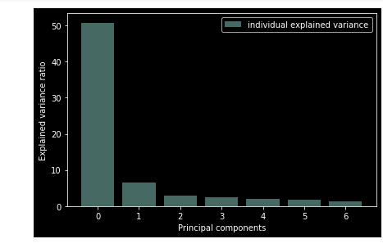
Results
> First principal component itself contribute 50%of information
> second component contribute 6% of information and the other components contribute (2,2,1,1) respectively
> Total 7 components contribute 63% in total.

Slide 10
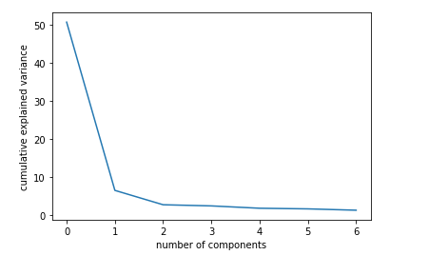
Results
> With the help of scree plot number of principal components with variance is captured

Slide 11
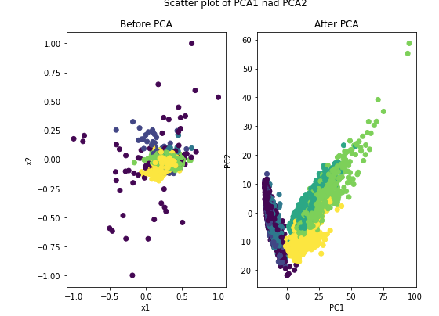
Results
For the comparison purpose variance(scatter plot ) of the data is visualized to understand the spread before and after PCA
Variance is improved along the PC1 and PC2 compared to original samples

Slide 12
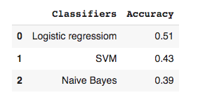
Results
To classify the activities 3 algorithms Logistic regression, SVM and Naive Bayes are implemented and compared in that Logistic regression scored the highest 51%

Slide 13
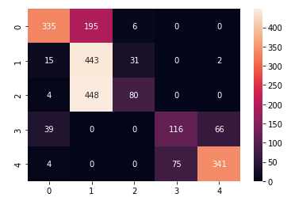
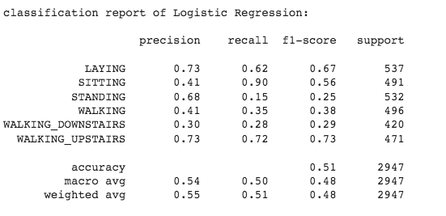
Results
Classification report and confusion matrix of the best performing algorithm

Slide 14
References
[1].V. Radhika, C. R. Prasad and A. Chakradhar, "Smartphone-Based Human Activities Recognition System using Random Forest Algorithm," 2022 International Conference for Advancement in Technology (ICONAT), 2022, pp. 1-4, doi: 10.1109/ICONAT53423.2022.9726006.
[2].​​A. A. Aljarrah and A. H. Ali, "Human Activity Recognition using PCA and BiLSTM Recurrent Neural Networks," 2019 2nd International Conference on Engineering Technology and its Applications (IICETA), 2019, pp. 156-160, doi: 10.1109/IICETA47481.2019.9012979.
[3].D. Thakur, A. Guzzo and G. Fortino, "t-SNE and PCA in Ensemble Learning based Human Activity Recognition with Smartwatch," 2021 IEEE 2nd International Conference on Human-Machine Systems (ICHMS), 2021, pp. 1-6, doi: 10.1109/ICHMS53169.2021.9582455.

Slide 15

Thank you!
This brings me to the end of my presentation

